Slide 1
Dynamic Programming-2
Marzieh Eskandari
NJIT

Slide 2

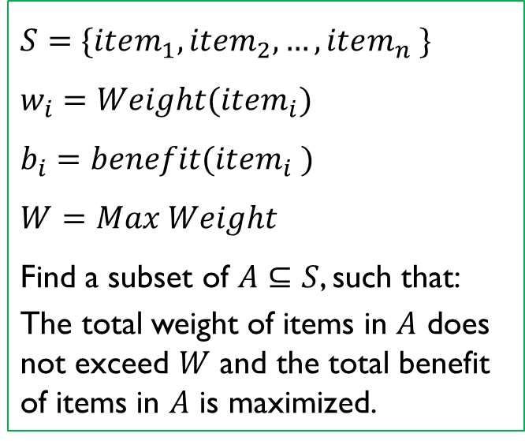
0,1-Knapsack problem
Item | Weight | Benefit
Camera | 10 | 320
Laptop | 20 | 400
Watch | 8 | 220
Guitar | 12 | 360
$$S=\{item_{1},item_{2},…,item_{n} \}$$
$$w_{i}=Weight(item_{i})$$
$$b_{i}=benefit(item_{i} )$$
$$W=Max Weight$$
Find a subset of $A⊆S$, such that:
The total weight of items in $A$ does not exceed $W$ and the total benefit of items in $A$ is maximized.
W=20 lbs
Notes:
The question is to select some items to maximize the benefit such that the total weight does not exceed a given value

Slide 3
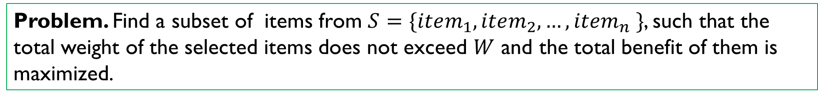
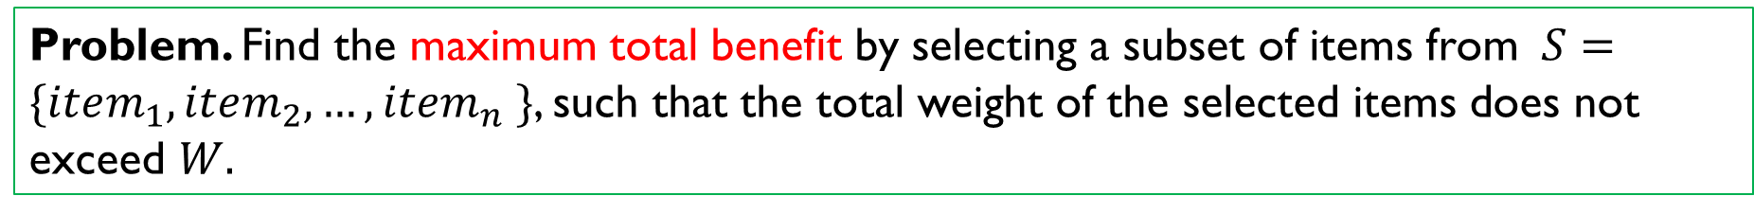
0,1-Knapsack problem
Problem. Find a subset of items from $S=\{item_{1},item_{2},…,item_{n} \}$, such that the total weight of the selected items does not exceed $W$ and the total benefit of them is maximized.
Problem. Find the maximum total benefit by selecting a subset of items from $S=\{item_{1},item_{2},…,item_{n} \}$, such that the total weight of the selected items does not exceed $W.$

Slide 4
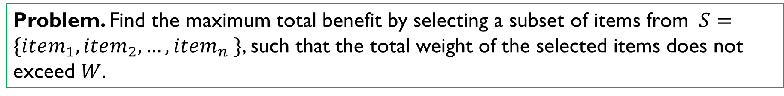
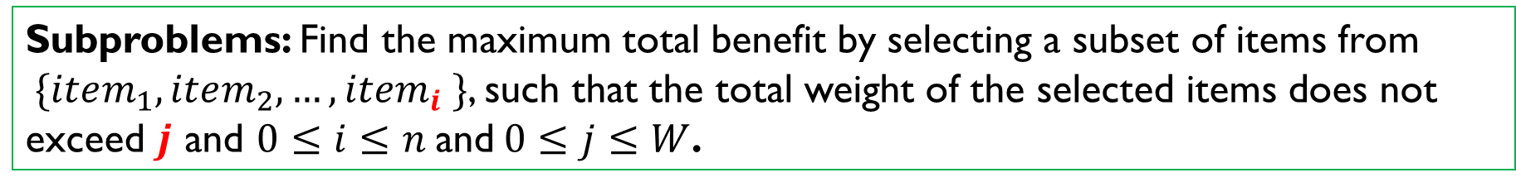
0,1-Knapsack problem: Subproblems
Problem. Find the maximum total benefit by selecting a subset of items from $S=\{item_{1},item_{2},…,item_{n} \}$, such that the total weight of the selected items does not exceed $W.$
Subproblems: Find the maximum total benefit by selecting a subset of items from $\{item_{1},item_{2},…,item_{i} \}$, such that the total weight of the selected items does not exceed $j$ and $0≤i≤n$and$0≤j≤W$.

Slide 5

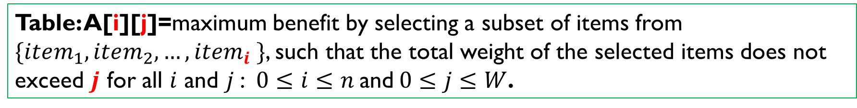
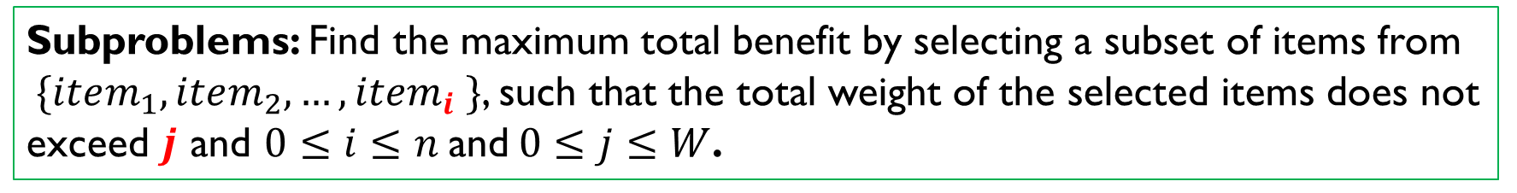
6. Find a subset of $A⊆S=\{item_{1},item_{2},…,item_{n} \}$, such that the total weight of items in $A$ does not exceed $W$ and the total benefit of items in $A$ is maximized.
0,1-Knapsack problem: Table
Subproblems: Find the maximum total benefit by selecting a subset of items from $\{item_{1},item_{2},…,item_{i} \}$, such that the total weight of the selected items does not exceed $j$ and $0≤i≤n$and$0≤j≤W$.
Table: A[i][j]=maximum benefit by selecting a subset of items from $\{item_{1},item_{2},…,item_{i} \}$, such that the total weight of the selected items does not exceed $j$ for all $i$ and $j$: $0≤i≤n$and$0≤j≤W$.

Slide 6
0,1-Knapsack problem: Table
Subproblems: Find the maximum total benefit by selecting a subset of items from $\{item_{1},item_{2},…,item_{i} \}$, such that the total weight of the selected items does not exceed $j$ and $0≤i≤n$and$0≤j≤W$.
Table: A[i][j]=max benefit using first $i$ items with capacity $j$
$0≤i≤n$and$0≤j≤W$

Slide 7

0,1-Knapsack problem: small problems
Table: A[i][j]=max benefit using first $i$ items with capacity $j$
$0≤i≤n$and$0≤j≤W$
Smallest problems:
A[i][0]=0: $0≤i≤n,$
A[0][j]=0: $0≤j≤W$
Main problem:
A[n][W]=?

Slide 8













0,1-Knapsack problem: Relation
1. Don't take item i:
The best you can do is what you could do with the first i-1 items at full capacity j.
So: $A[i−1][j]$
2. Take item i:
$$j$$
$$w_{1}$$
$$w_{2}$$
$$…$$
$$w_{i−1}$$
$$w_{i}$$
$$j$$
$$w_{1}$$
$$w_{2}$$
$$…$$
$$w_{i−1}$$
$$w_{i}$$

Slide 9



0,1-Knapsack problem: Relation
1. Don't take item i:
The best you can do is what you could do with the first i-1 items at full capacity j.
So: $A[i−1][j]$
2. Take item i:
You spend $w_{i}$ units of capacity, and you're left with $j − w_{i}$.
You now add the benefit of item $i$ to the best you could do with the first i-1 items and this reduced capacity.
So: $A[i−1][j − w_{i}] +b_{i}$
$$j$$
$$w_{1}$$
$$w_{2}$$
$$…$$
$$w_{i−1}$$
$$w_{i}$$
$$j−w_{i}$$
$$w_{1}$$
$$w_{2}$$
$$…$$
$$w_{i−1}$$
$$w_{i}$$

Slide 10

0,1-Knapsack problem: Relation
relation: $A\left[i\right]\left[j\right]=max⁡\{ A\left[i − 1\right]\left[j − w_{i}\right]+b_{i},A\left[i − 1\right]\left[j\right]\}$
what if $j − w_{i}<0 ????$

Slide 11
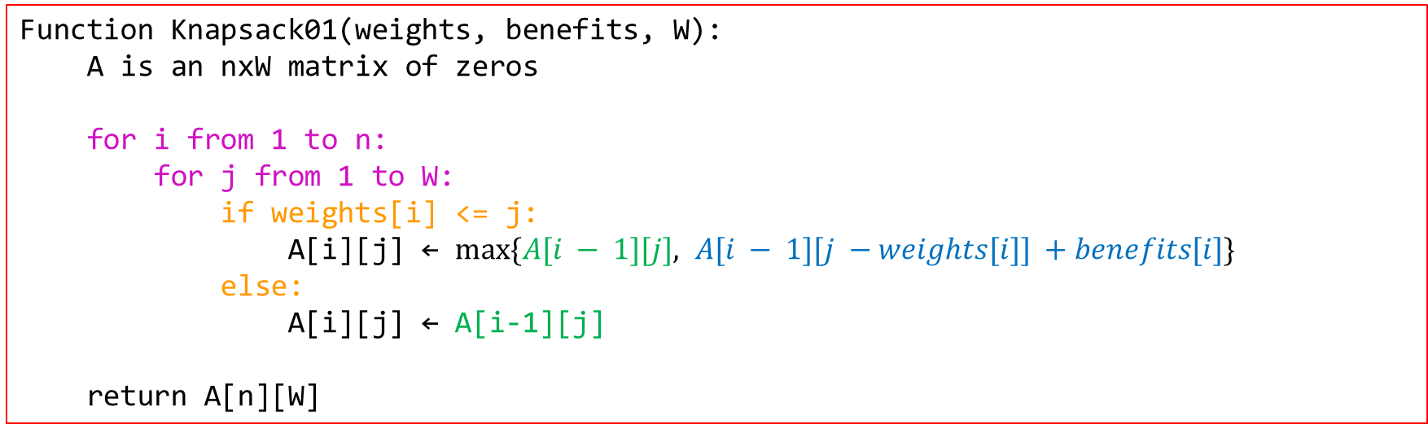
0,1-Knapsack problem
Function Knapsack01(weights, benefits, W):
A is an nxW matrix of zeros
for i from 1 to n:
for j from 1 to W:
if weights[i] <= j:
A[i][j] ← $max⁡\{A[i − 1][j], A[i − 1][j −weights[i]] +benefits[i]\}$
else:
A[i][j] ← A[i-1][j]
return A[n][W]

Slide 12
Class work

Slide 13
Money Change Problem
Compute the minimum number of coins needed to change the given value into coins with denominations 1, 3, and 4.
Input: An integer money, n.
Output: The minimum number of coins that changes n.
3
4
1
n=4k+2
k(4)+2(1) (k-1)(4)+2(3)
k+2 coins k+1 coins
6=4+1+1
6=3+3
10=4+4+1+1
10=4+3+3

Slide 14
SubProblems
Find the minimum number of coins with denominations 1, 3 and 4 that changes $i, 0≤i≤n$.

Slide 15
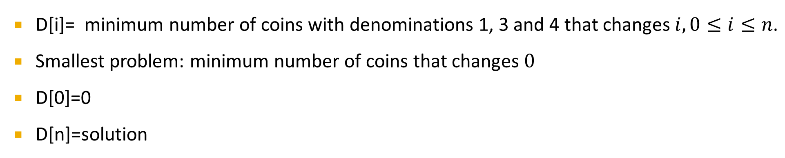
Table
D[i]= minimum number of coins with denominations 1, 3 and 4 that changes $i, 0≤i≤n\text{.}$
Smallest problem: minimum number of coins that changes $0$
D[0]=0
D[n]=solution

Slide 16
Relation
Choose
Choose
Choose
1
3
4

Slide 17
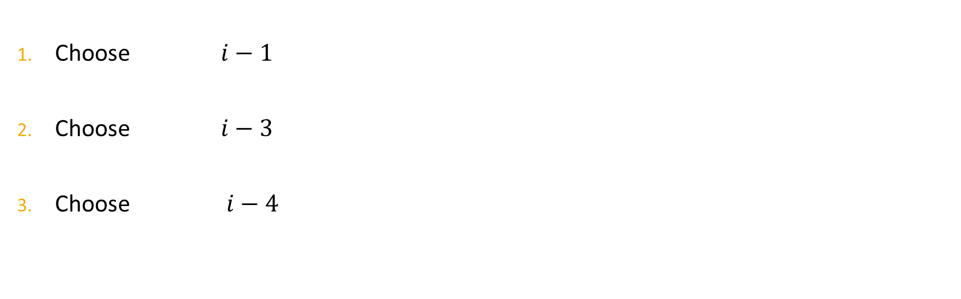
Relation
D[i]= minimum number of coins with denominations 1, 3 and 4 that changes $i$
Choose $i−1$
Choose $i−3$
Choose $i−4$
1
3
4

Slide 18
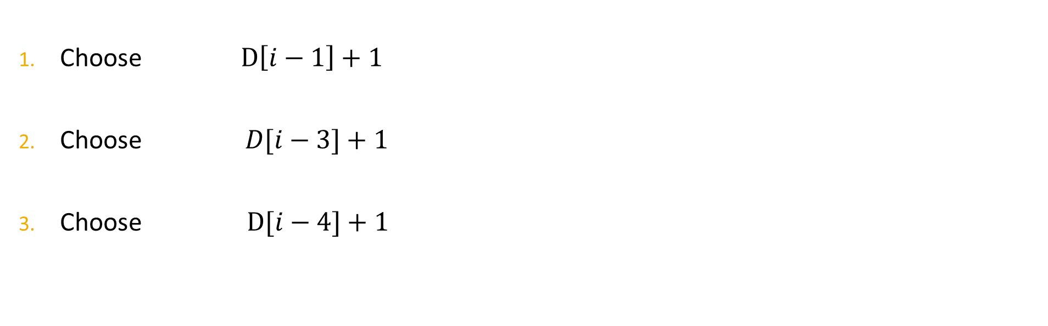
Relation
D[i]= minimum number of coins with denominations 1, 3 and 4 that changes $i$
Choose $D\left[i−1\right]+1$
Choose $D[i−3]+1$
Choose $D[i−4]+1$
1
3
4

Slide 19
Relation
Choose $D\left[i−1\right]+1$
Choose $D[i−3]+1$
Choose $D[i−4]+1$
1
3
4
$$D\left[i\right]=min⁡\{D\left[i−1\right]+1,D\left[i−3\right]+1,D\left[i−4\right]+1\}$$

Slide 20
Inductive Approach
create array D[0..n]
D[0]=0
for i=1 to n do
min_coins=1+D[i-1]
if i-3>=0 then
min_coins=min(min_coins,D[i-3]+1)
if i-4>=0 then
min_coins=min(min_coins,D[i-4]+1)
D[i]=min_coins
return D[n]

Slide 21
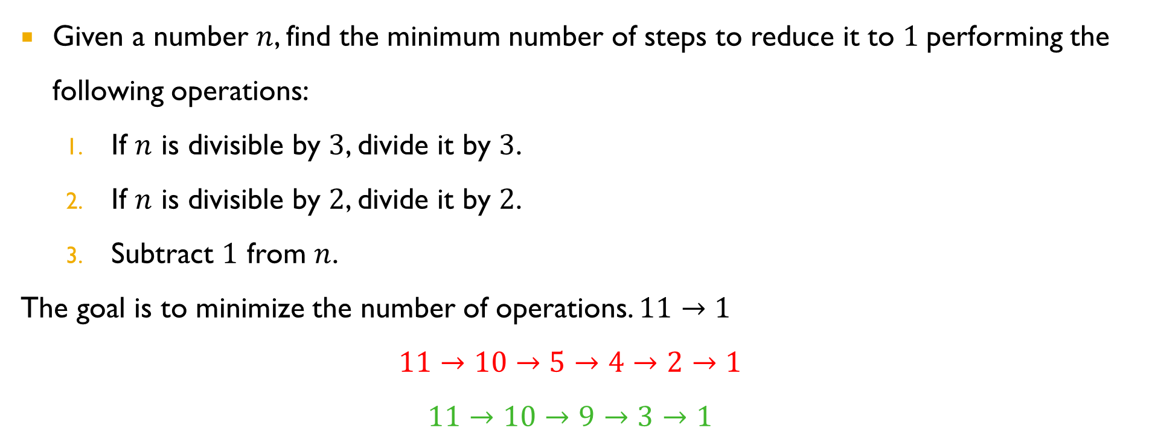

Minimum Steps to Reduce a Number to $1$
Given a number $n$, find the minimum number of steps to reduce it to $1$performing the following operations:
If $n$ is divisible by $3$, divide it by $3$.
If $n$ is divisible by $2$, divide it by $2$.
Subtract $1$ from $n$.
The goal is to minimize the number of operations. $11→1$
$$11→10→5→4→2→1$$
$$11→10→9→3→1$$

Slide 22
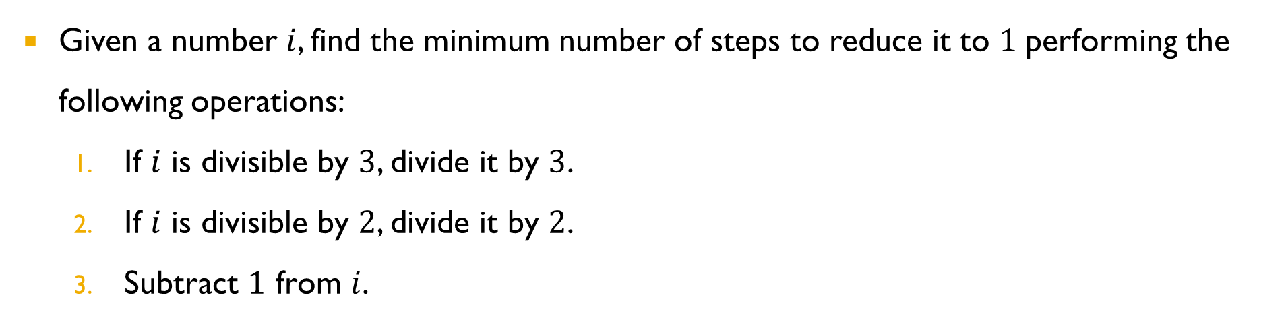
Subproblems
Given a number $i$, find the minimum number of steps to reduce it to $1$performing the following operations:
If $i$ is divisible by $3$, divide it by $3$.
If $i$ is divisible by $2$, divide it by $2$.
Subtract $1$ from $i$.

Slide 23
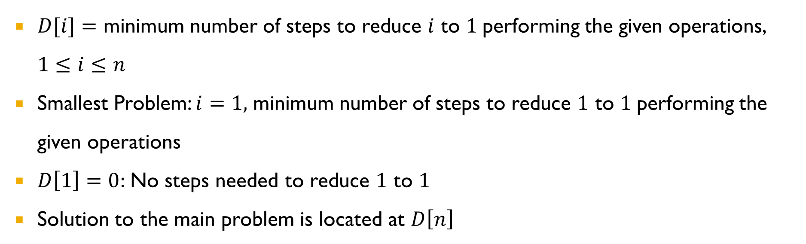
Table
$D[i]=$ minimum number of steps to reduce $i$ to $1$performing the given operations, $1≤i≤n$
Smallest Problem: $i=1,$ minimum number of steps to reduce $1$ to $1$performing the given operations
$D\left[1\right]=0:$No steps needed to reduce $1$ to $1$
Solution to the main problem is located at $D\left[n\right]$

Slide 24
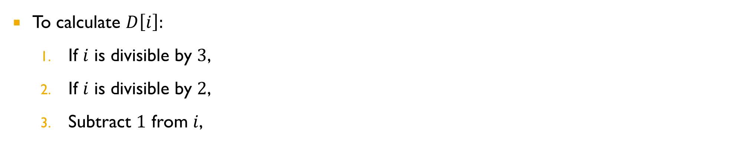
Relation
$D[i]=$ minimum number of steps to reduce $i$ to $1$performing the given operations
To calculate $D\left[i\right]:$
If $i$ is divisible by $3$, divide it by $3$and get $i/3$, ($1$ operation), solve the problem for $i/3$.
If $i$ is divisible by $2$, divide it by $2$and get $i/2$, ($1$ operation), solve the problem for $i/2$.
Subtract $1$ from $i$, ($1$ operation), solve the problem for $i−1$.

Slide 25
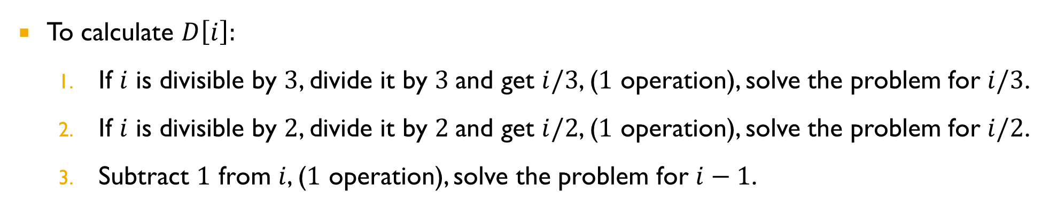
Relation
$D[i]=$ minimum number of steps to reduce $i$ to $1$performing the given operations
To calculate $D\left[i\right]:$
If $i$ is divisible by $3$, divide it by $3$and get $i/3$, ($1$ operation), solve the problem for $i/3$.
If $i$ is divisible by $2$, divide it by $2$and get $i/2$, ($1$ operation), solve the problem for $i/2$.
Subtract $1$ from $i$, ($1$ operation), solve the problem for $i−1$.

Slide 26
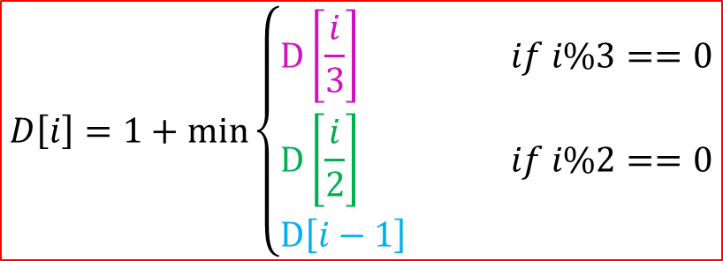
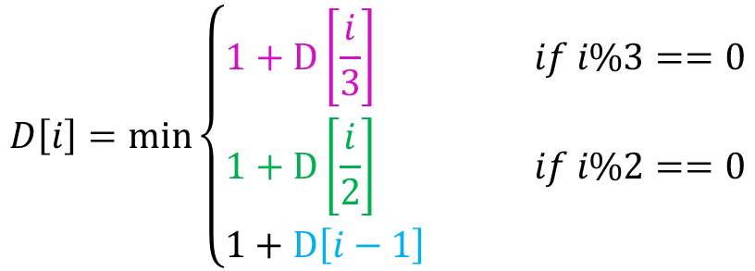
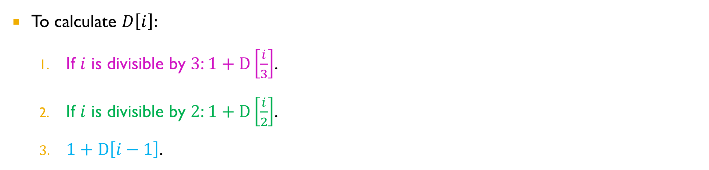
Relation
$D[i]=$ minimum number of steps to reduce $i$ to $1$performing the given operations
To calculate $D\left[i\right]:$
If $i$ is divisible by $3$: $1+D\left[\frac{i}{3}\right]$.
If $i$ is divisible by $2$: $1+D\left[\frac{i}{2}\right]$.
$1+D\left[i−1\right]$.
$$D\left[i\right]=\min\left\{\begin{aligned}1+D\left[\frac{i}{3}\right] if i\%3==0 \\ 1+D\left[\frac{i}{2}\right] if i\%2==0 \\ 1+D\left[i−1\right] \end{aligned}\right.$$
$$D\left[i\right]=1+min\left\{\begin{aligned}D\left[\frac{i}{3}\right] if i\%3==0 \\ D\left[\frac{i}{2}\right] if i\%2==0 \\ D\left[i−1\right] \end{aligned}\right.$$

Slide 27
Inductive approach
min_steps_to_one(n):
create array D[1..n]
D[1] = 0
for i = 2 to n do
min_steps = D[i-1]
if i % 2 == 0 then
min_steps = min(min_steps, D[i/2])
if i % 3 == 0 then
min_steps = min(min_steps, D[i/3])
D[i] = 1 + min_steps
return D[n]

Slide 28
Any Question??
Have a nice day!

